Slide 1
Rating Prediction Project
Submitted By:- Sujay Nimbalkar
Submitted To:- Swati Mahaseth (Flip Robo Technologies)
Acknowldgement
Here we have scrapped the Data from “Flipkart com” in order to scrape the reviews of the various products which were necessary for the project phase which helped us and gave us the idea to make a dataset and finally we can work on that dataset to build a model and prepare the solution for the given problem statement
Introduction:-
We have a client who has a website where people write different reviews for technical products. Now they are adding a new feature to their website i.e. The reviewer will have to add stars(rating) as well with the review. The rating is out 5 stars and it only has 5 options available 1 star, 2 stars, 3 stars, 4 stars, 5 stars. Now they want to predict ratings for the reviews which were written in the past and they don’t have a rating. So, we have to build an application which can predict the rating by seeing the review
Conceptional Backgroud:
Now a days Ecommerce platforms are the most convenient way for the people to get the things they want hence there is a huge competation between the various Ecommerce platforms among themselves People buy they want and rate the products as well which helps the buyer to get the information of the products in brief looking at the rating of the product.
Review of Litrature:

Slide 2
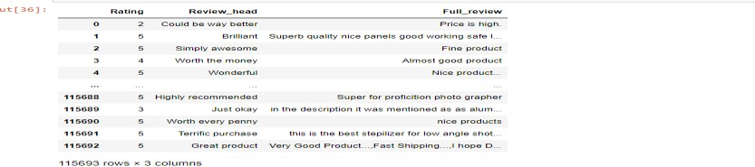
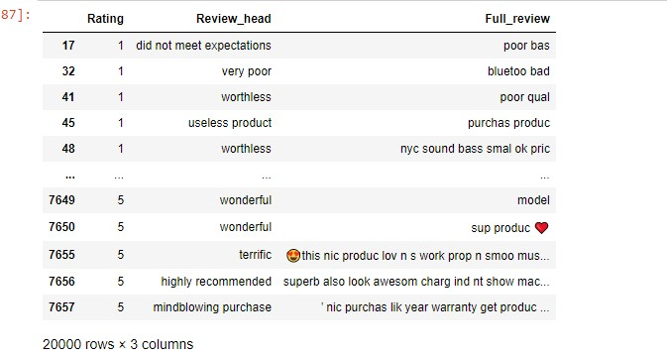
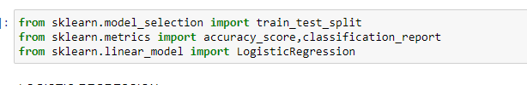
This project is all about the prediction of the rating given by the customers on the Ecommerce platform which will give a detailed idea The data Is been scapped from one of the Ecommerce platform to study and the reviews have been collected of various usefull products
Motivation of the Problem Undertaken
Here we have taken initiative at our fullest to solve the problem. We have scrapped the data from Flipkart com of the various useful products as you can see in the dataset along with the reviews of the customer which is gonna help us We are going to use this data set along with the machine learning algorithms with various parameters to get an best accuracy score so we are going to see various algorithms in this project applied which are going to give us the best accuracy score
Steps followed for model Building Phase are
1. Scrapping the data
As we can see that the data have been scrapped from Flipkart along with the customer reviews. After deleting the data which is not required here finally we have got the new dataset with us
Further we imported necessary Libraries required
Further we went for Logistic Regression,
We got the score of 0.9512 as you will get to see in the below picture

Slide 3
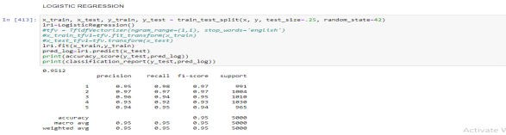
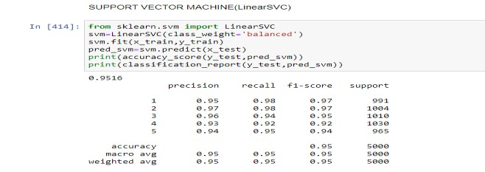
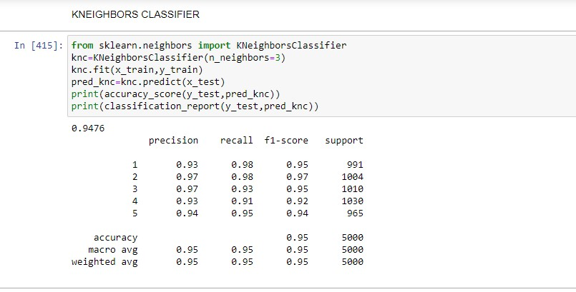
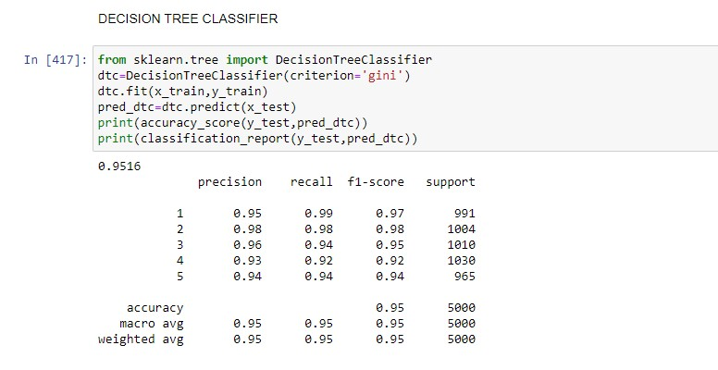
Support Vector Machine:-
With Support Vector Machine there is no major difference in the score as you will able to see in the below picture
With KNEIGHBOURS CLASSIFIER the score has been changed and you can see the score has been increased to 0.9476.
With DecisionTree Classifier the score has again increased to 0.9516 as it is shown in the picture below
With Random Forest classifier we got the accuracy score of 0.9516. Further we done the crossvalidation with all the algorithms.
All the algorithms performed well except the kneighbours classifier

Slide 4
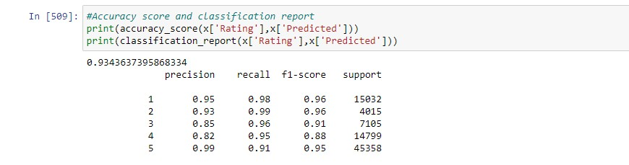
Thus we further proceed to ROC-AUC curve scoring to get more better results.
The Random Forest Classifier has been selected as the best model as it has the lowest difference between the accuracy_score and the cross_val_score,a very good f-1 score and the highest roc_auc_score. The f-1 score being the most important metric in reaching this conclusion.
Hyperparameter Tuning the Random Forest Classifier. The LinearSVC algorithm cannot be used here as it does not have the predict_proba method.
Finally proceding with the gridsearchCV we got a best accuracy score and finally we saved and concluded to save our model with RandomForestModel with Count vectorizer
Below is the Accuracy and classification Report
Thank You.

